Slide 1
Chapter 1: Revision Tour 1
Firdaus amrut centre school
Prepared by: Jhankhana Koshti

Slide 2
What is Python?
Python is a popular programming language. It was created by Guido van Rossum, and released in 1991.
It is used for:
web development (server-side)
software development
mathematics
system scripting

Slide 3
print("Hello, World!")

Slide 4
Python Indentation
Indentation refers to the spaces at the beginning of a code line.
Where in other programming languages the indentation in code is for readability only, the indentation in Python is very important.
Python uses indentation to indicate a block of code.

Slide 5
Example
Syntax Error:
if 5 > 2:
print("Five is greater than two!")
Example
if 5 > 2:
print("Five is greater than two!")

Slide 6
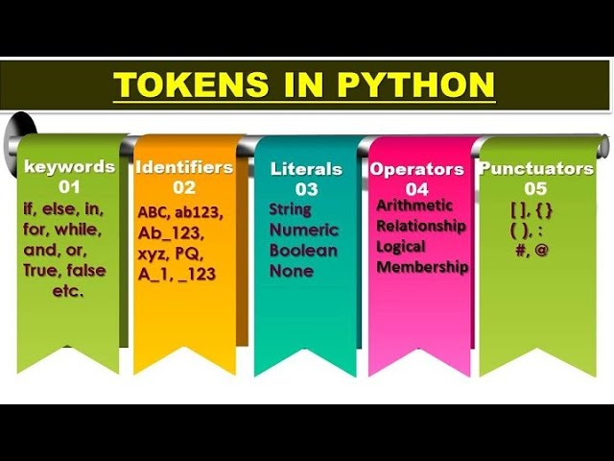

Slide 7
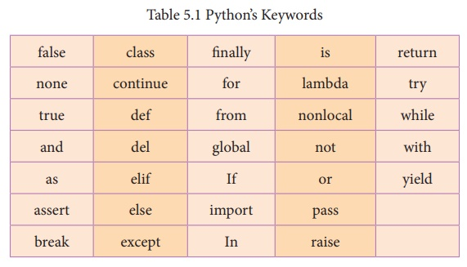
Keywords: Keywords are words that have some special meaning or significance in a programming language. They can’t be used as variable names, function names, or any other random purpose. They are used for their special features. In Python we have 33 keywords some of them are: try, False, True, class, break, continue, and, as, assert, while, for, in, raise, except, or, not, if, elif, print, import, etc.

Slide 8
Identifiers: Identifiers are the names given to any variable, function, class, list, methods, etc. for their identification. Python is a case-sensitive language and it has some rules and regulations to name an identifier. Here are some rules to name an identifier:-
As stated above, Python is case-sensitive. So case matters in naming identifiers.
Identifier starts with a capital letter (A-Z) , a small letter (a-z) or an underscore( _ ). It can’t start with any other character.
Except for letters and underscore, digits can also be a part of identifier but can’t be the first character of it.
Any other special characters or whitespaces are strictly prohibited in an identifier.
An identifier can’t be a keyword.

Slide 9
Literals or Values: Literals are the fixed values or data items used in a source code. Python supports different types of literals such as:
String Literals: The text written in single, double, or triple quotes represents the string literals in Python. For example: “Computer Science”, ‘sam’, etc. We can also use triple quotes to write multi-line strings.
(ii) Character Literals: Character literal is also a string literal type in which the character is enclosed in single or double-quotes.

Slide 10
(iii) Numeric Literals: These are the literals written in form of numbers. Python supports the following numerical literals:
Integer Literal: It includes both positive and negative numbers along with 0. It doesn’t include fractional parts. It can also include binary, decimal, octal, hexadecimal literal.
Float Literal: It includes both positive and negative real numbers. It also includes fractional parts.
Complex Literal: It includes a+bi numeral, here a represents the real part and b represents the complex part.
(iv) Boolean Literals: Boolean literals have only two values in Python. These are True and False.
(v) Special Literals: Python has a special literal ‘None’. It is used to denote nothing, no values, or the absence of value.

Slide 11
(vi) Literals Collections: Literals collections in python includes list, tuple, dictionary, and sets.
List: It is a list of elements represented in square brackets with commas in between. These variables can be of any data type and can be changed as well.
Tuple: It is also a list of comma-separated elements or values in round brackets. The values can be of any data type but can’t be changed.
Dictionary: It is the unordered set of key-value pairs.
Set: It is the unordered collection of elements in curly braces ‘{}’.

Slide 12
Operators: These are the tokens responsible to perform an operation in an expression. The variables on which operation is applied are called operands. Operators can be unary or binary. Unary operators are the ones acting on a single operand like complement operator, etc. While binary operators need two operands to operate.

Slide 13
Punctuators: These are the symbols that used in Python to organize the structures, statements, and expressions. Some of the Punctuators are: [ ] { } ( ) @ -= += *= //= **== = , etc.

Slide 14
Python Comments: Importance, Types and Correct Way to Use
Why are Comments Used in Python?
Comments have been an integral part of programming languages, and every language have different ways of using comments.
Just like any other language, comments in Python serve following purpose:
Enhance code readability
Explaining code to other
Understanding code if studied after some time
Documenting the steps and needs for a function
Sharing code with fellow developers
Collaborating with multiple people.

Slide 15
Types of Comments in Python
Single line Comments
Multiline Comments
String Literals
Docstring Comments

Slide 16
1. Single-Line Comments
Python single-line comment starts with the hashtag symbol (#) with no white spaces and lasts till the end of the line.
If the comment exceeds one line then put a hashtag on the next line and continue the Python Comment.
Python’s single-line comments are proved useful for supplying short explanations for variables, function declarations, and expressions. See the following code snippet demonstrating single line comment:
# Print “GeeksforGeeks !” to console
print("GeeksforGeeks")

Slide 17
2. Multi-Line Comments
a) Multiline comments using multiple hashtags (#)
We can multiple hashtags (#) to write multiline comments in Python. Each and every line will be considered as a single-line comment.
# Python program to demonstrate
# multiline comments
print("Multiline comments")

Slide 18
Docstring
Python docstring is the string literals with triple quotes that are appeared right after the function.
It is used to associate documentation that has been written with Python modules, functions, classes, and methods.
It is added right below the functions, modules, or classes to describe what they do. In Python, the docstring is then made available via the __doc__ attribute.
def multiply(a, b):
"""Multiplies the value of a and b"""
return a*b
# Print the docstring of multiply function
print(multiply.__doc__)

Slide 19
Right Way to Write Comments
Comments serve the main purpose to explain your code. Developers use healthy comment writing practice for better understanding of the code.
Some of the tips you can follow, to make your comments effective are:
Comments should be short and precise.
Use comments only when necessary, don’t clutter your code with comments.
Comment should have some meaning.
Avoid writing generic or basic comments.
Write comments that are self explanatory.

Slide 20
Variables
Python Variable is containers that store values.
Python is not “statically typed”.
We do not need to declare variables before using them or declare their type.
A variable is created the moment we first assign a value to it.
A Python variable is a name given to a memory location.
It is the basic unit of storage in a program.

Slide 21
Example of Variable in Python
An Example of a Variable in Python is a representational name that serves as a pointer to an object. Once an object is assigned to a variable, it can be referred to by that name. In layman’s terms, we can say that Variable in Python is containers that store values.
Here we have stored “Geeksforgeeks” in a variable var, and when we call its name the stored information will get printed.
Var = “Firdaus Amrut Centre School"
print(Var)

Slide 22
Rules for Python variables
A Python variable name must start with a letter or the underscore character.
A Python variable name cannot start with a number.
A Python variable name can only contain alpha-numeric characters and underscores (A-z, 0-9, and _ ).
Variable in Python names are case-sensitive (name, Name, and NAME are three different variables).
The reserved words(keywords) in Python cannot be used to name the variable in Python.

